Slide 1
Employee Data Analysis using Excel
STUDENT NAME: SACHIN T
REGISTER NO: 2213211042032
DEPARTMENT: B. COM(CORPORATE SECRETARYSHIP)
COLLEGE: PRESIDENCY COLLEGE
USER NAME: unm13212213211042032

Slide 2
PROJECT TITLE
Employee Performance Analysis using Excel

Slide 3
AGENDA
Problem Statement
Project Overview
End Users
Our Solution and Proposition
Dataset Description
Modelling Approach
Results and Discussion
Conclusion

Slide 4

PROBLEM STATEMENT
To write a problem statement on employee performance, you need to identify the specific area of performance that is problematic, such as low productivity, high absenteeism, or poor quality of work. Then, you should describe the impact of this problem on the organization, such as decreased revenue or dissatisfied customers.

Slide 5

PROJECT OVERVIEW
.
*Data Organization**: Structuring data in a way that allows for meaningful analysis. This includes setting up clear columns for metrics such as performance ratings, sales figures, or project completion rates.
*Data Integration**: Combining data from multiple sources or departments may require advanced Excel functions like VLOOKUP, HLOOKUP, or Power Query.
By addressing these challenges, you can effectively use Excel to analyze employee performance and derive actionable insights.

Slide 6

WHO ARE THE END USERS?
ORGANISATION
*
*
MANAGERS
EMPLOYEES
*

Slide 7

OUR SOLUTION AND ITS VALUE PROPOSITION
Filtering to filter and to delete the blank values Pivot table to aggregate values on basis of count Chart graph to visualise the data in bar format

Slide 8
Dataset Description
The dataset used in this capstone project is sourced from the Google Advanced Data Analysis course. It encompasses a comprehensive collection of attributes concerning employees, ranging from demographic details to job-related factors. The primary objective of this analysis is to forecast employee turnover and discern the underlying factors contributing to employee attrition.
Satisfaction Level Last Evaluation Number of Project Average Monthly Hours Time Spend Company Work Accident Promotion Last 5 Years Department Salary

Slide 9

THE "WOW" IN OUR SOLUTION
Way of Working (WoW) describes how individuals work with each other, communicate, make decisions within a team. It combines practices, processes, agreements, shared expectations, ground rules etc. In order for the team to collaborate and achieve the desired results.
3/21/2024 Annual Review
9

Slide 10
MODELLING
Modeling employee performance analysis in Excel involves creating structured approaches to evaluate and forecast performance. Here’s a step-by-step guide to modeling employee performance using Excel:
*Data Preparation
*Descriptive Statistics
*Performance Metrics
*Trend Analysis- Time Series Analysis
*Comparative Analysis
*Predictive Modelling
*Visualization - Charts and Graphs
By following these steps, you can create effective models in Excel to analyze employee performance, enabling data-driven decision-making and performance management.
10

Slide 11
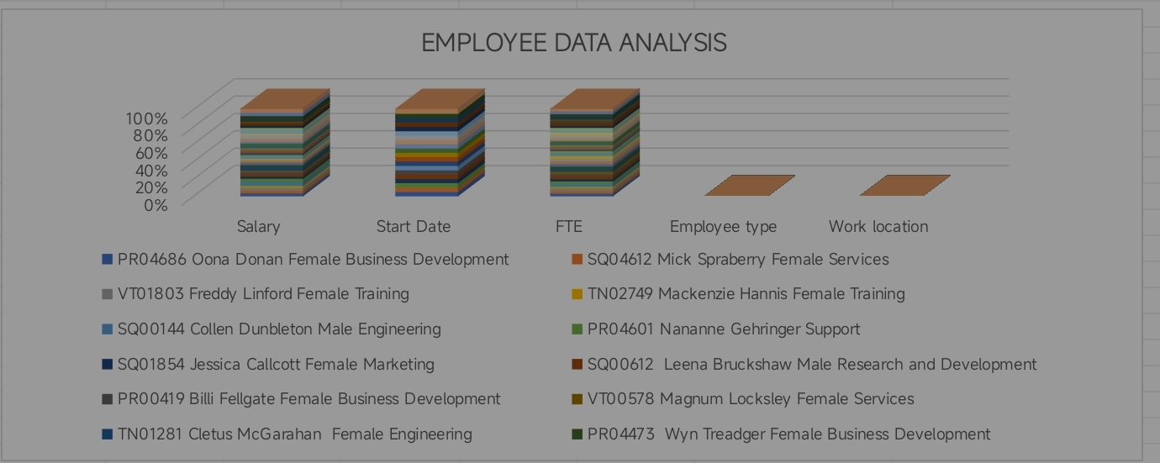
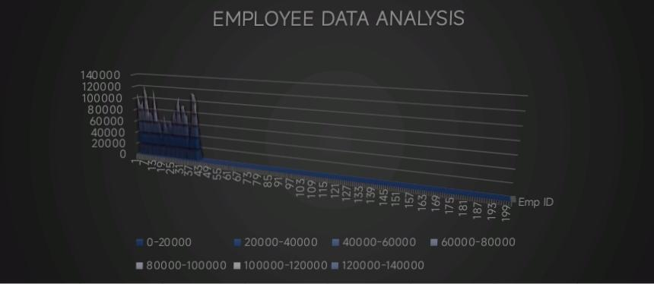
RESULTS
11

Slide 12
conclusion
In ZoneA “exceeds” category lead by full time employees whereas in other two zones lead by part-time employees. In Zone A “fully meet” category is lead by full-time employees whereas other two payzones lead by temporary employees.

